Slide 1

Moonitor16s
Safety on Battery Systems

Slide 2
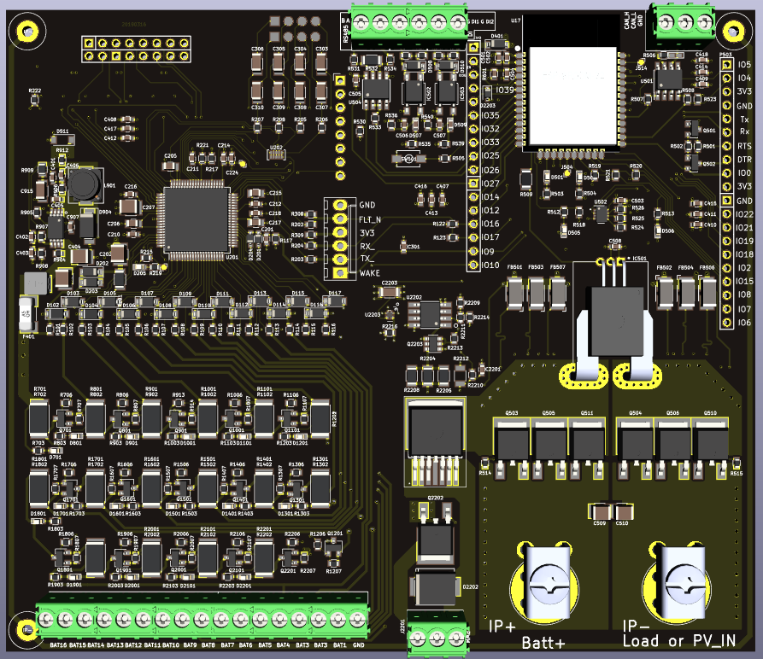

Slide 3
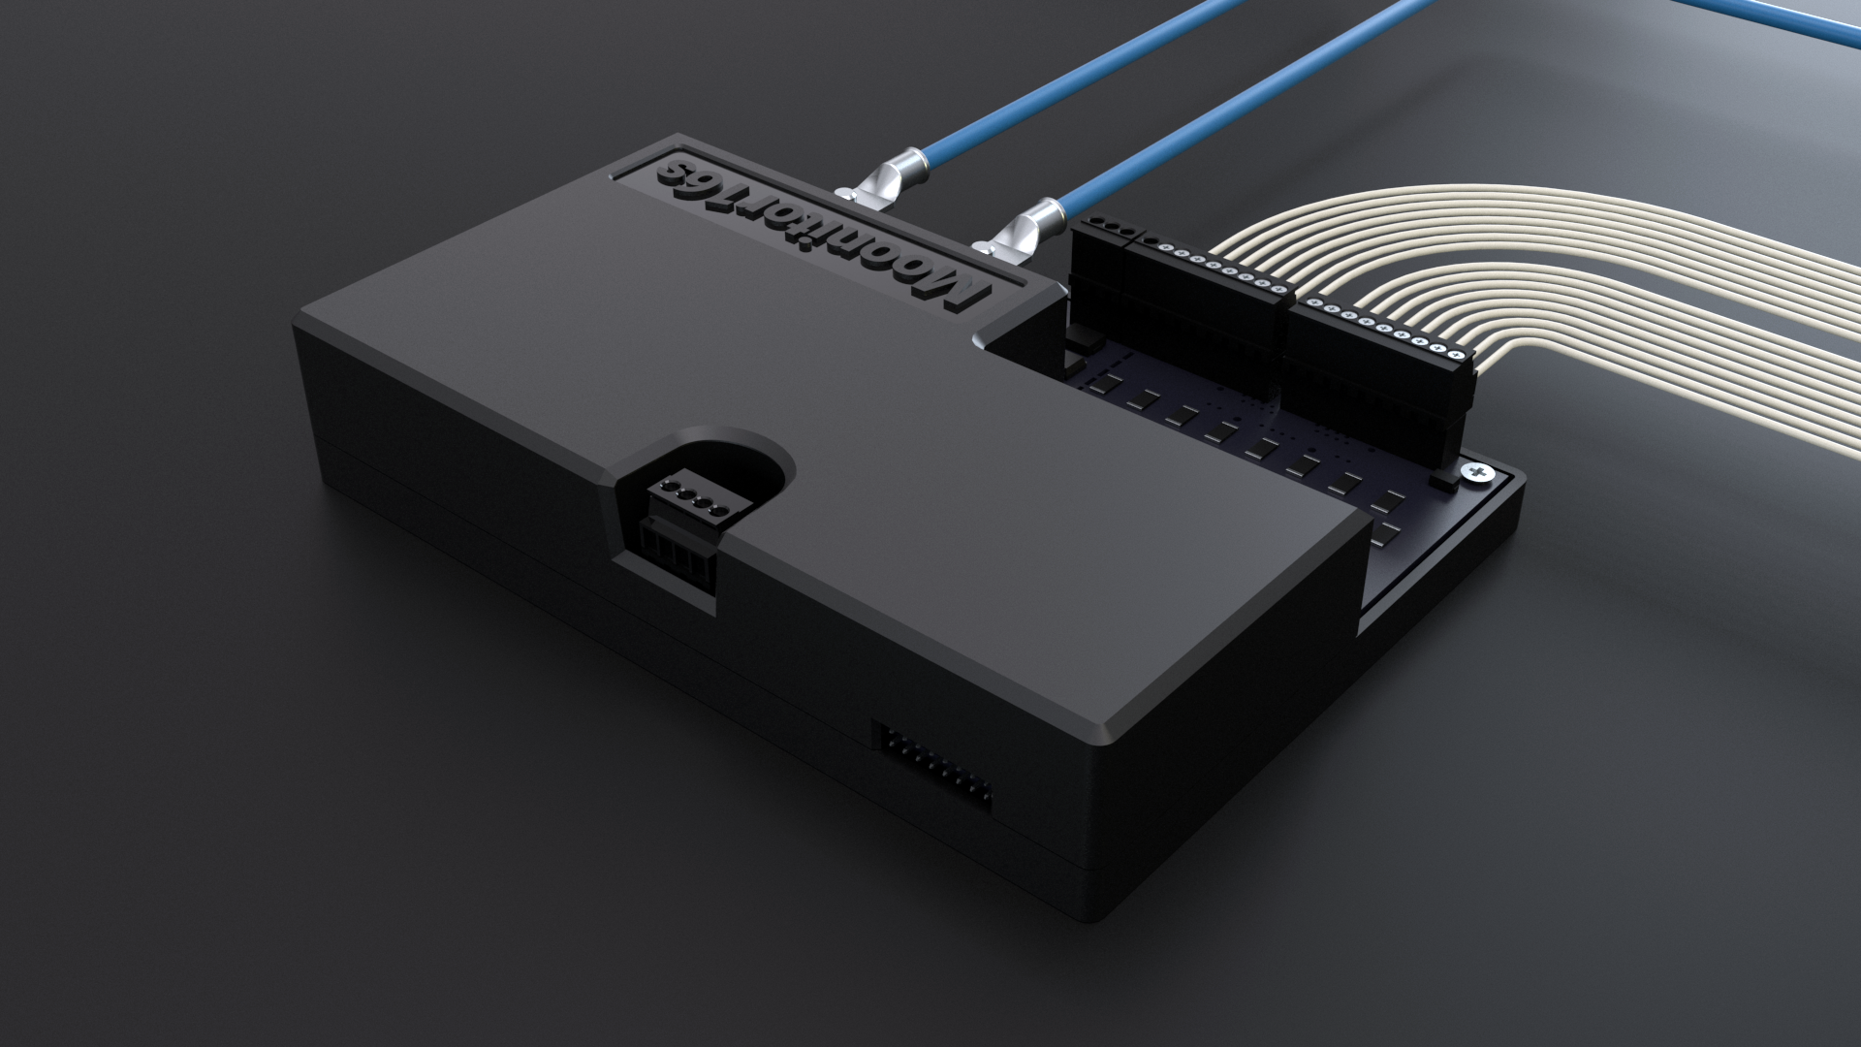

Slide 4
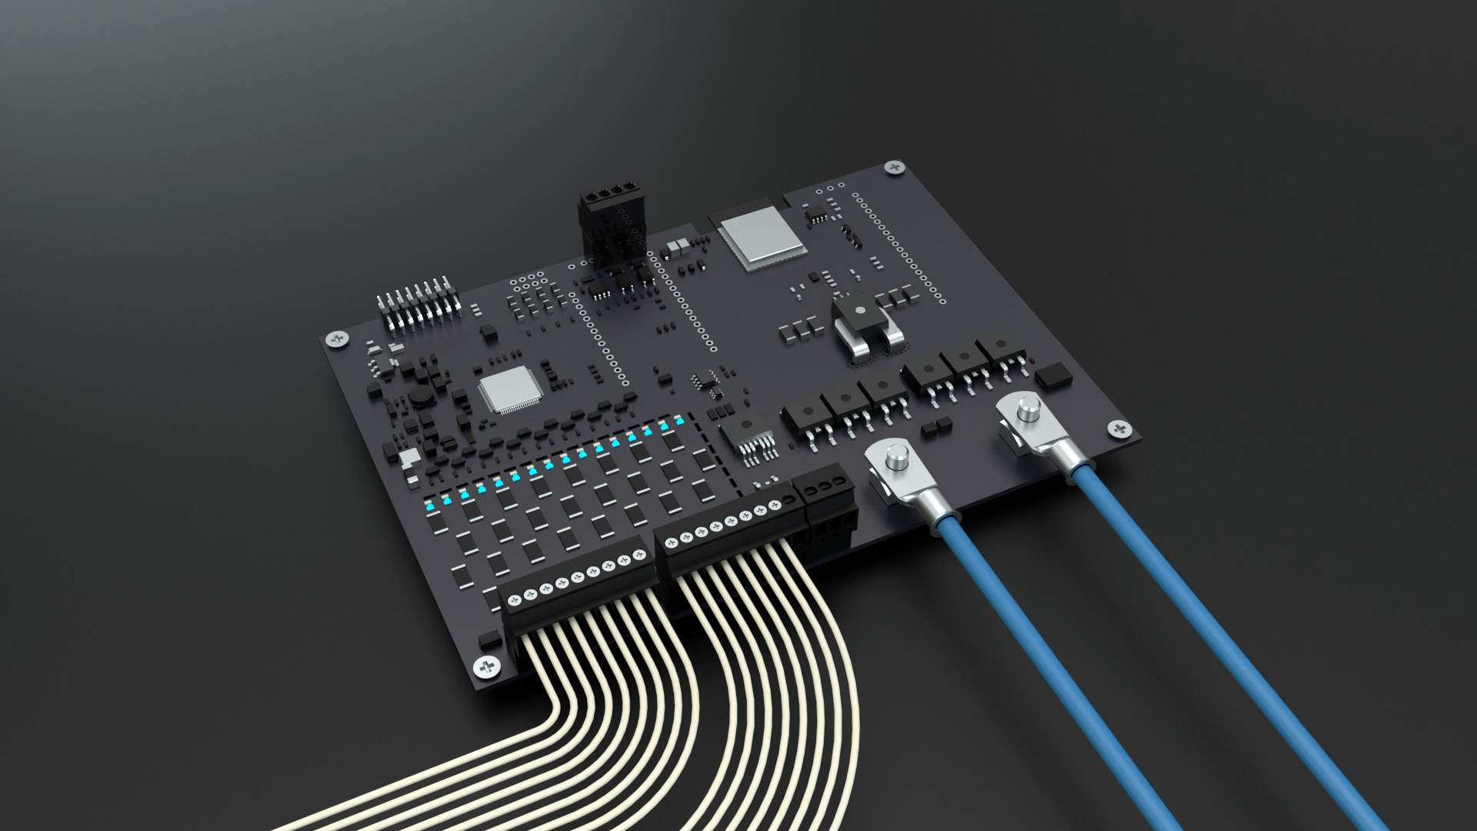

Slide 5
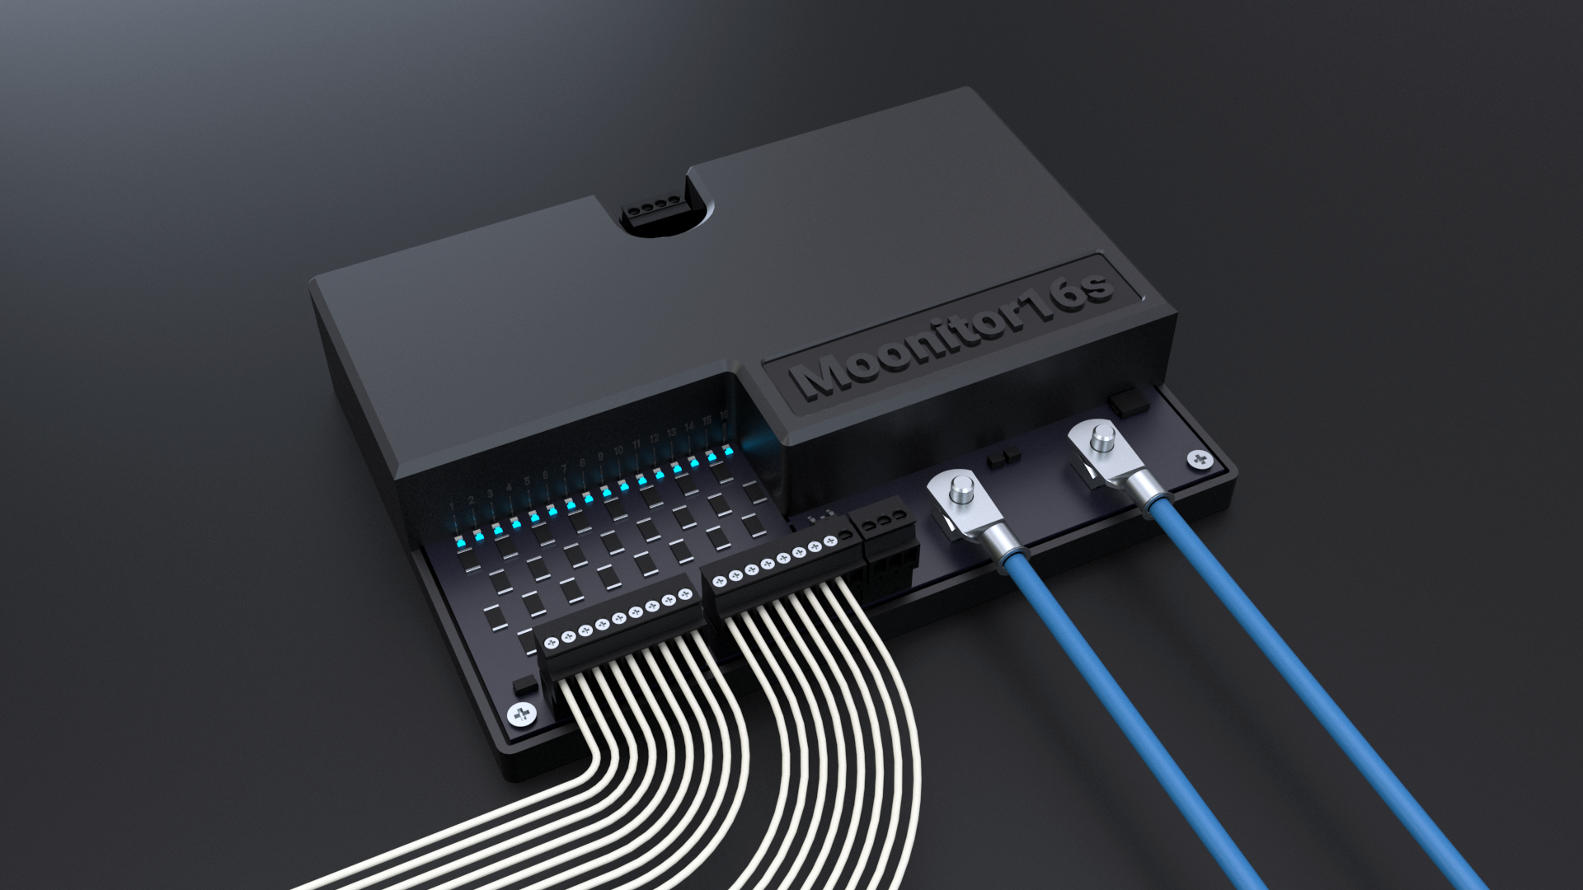

Slide 6
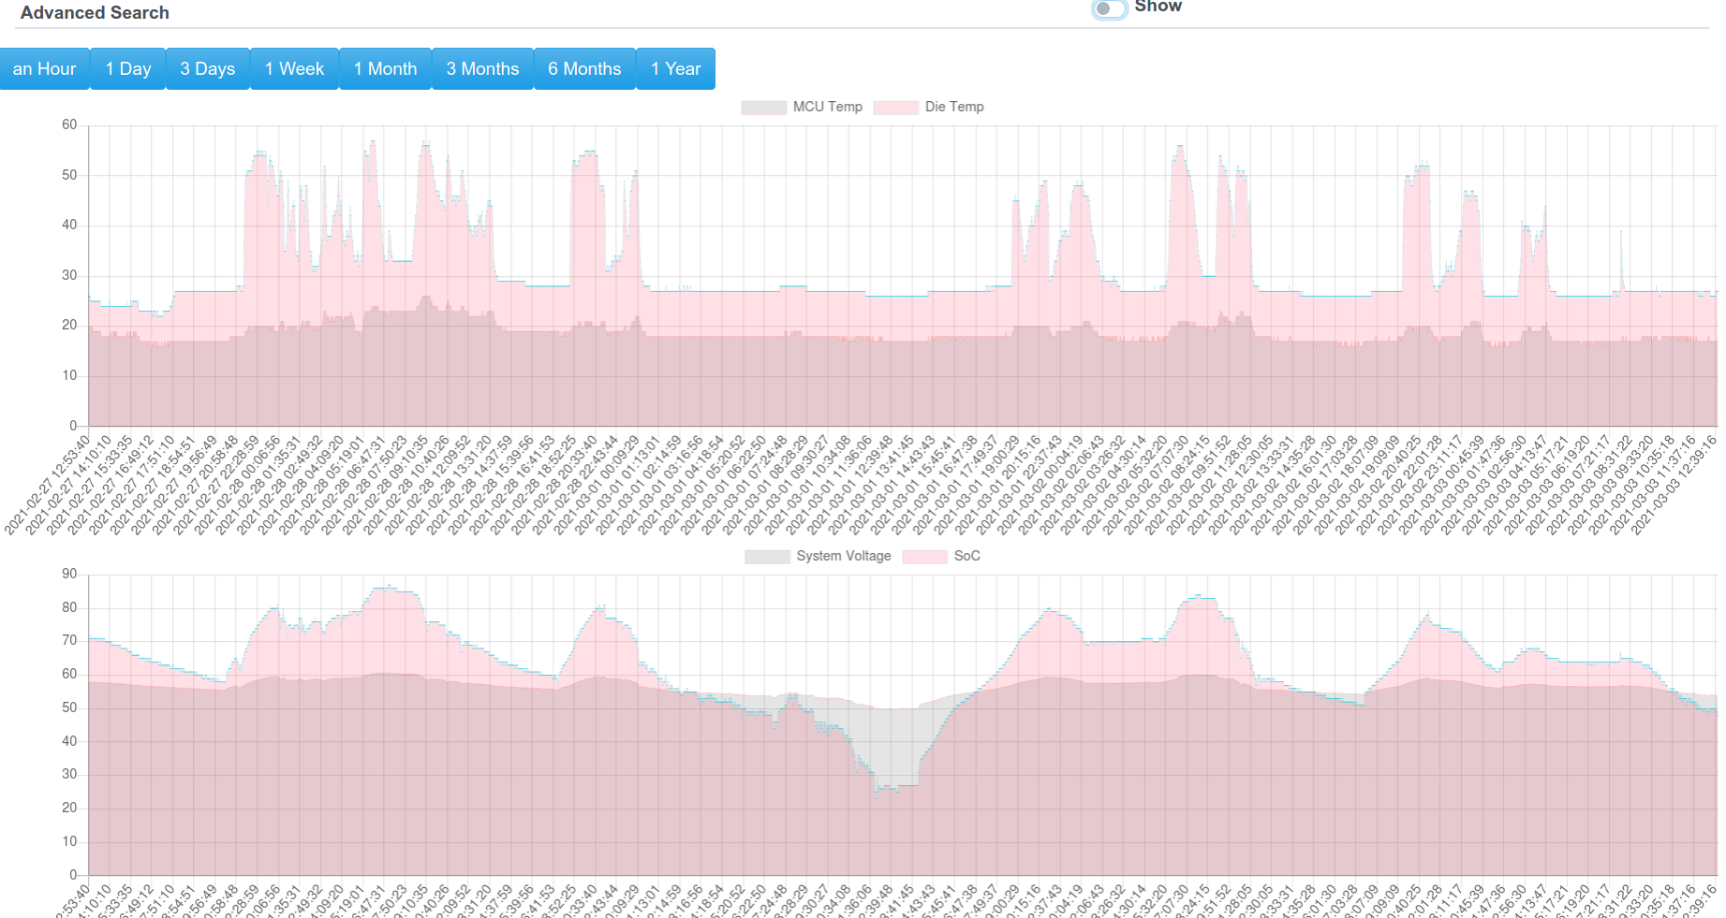

Slide 7
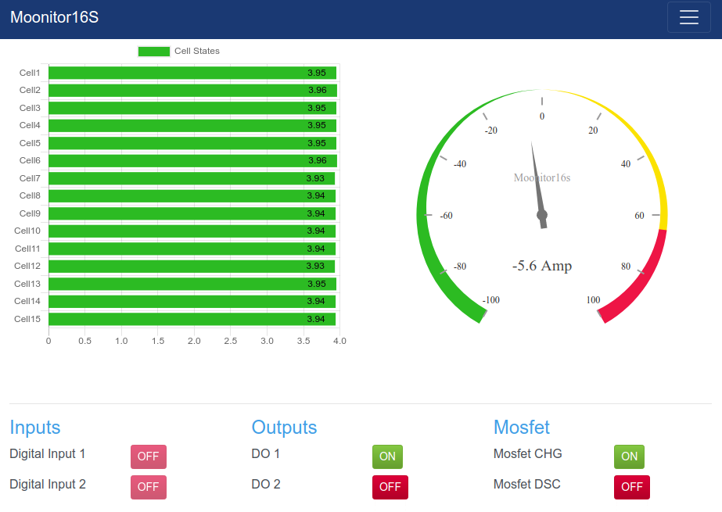

Slide 8
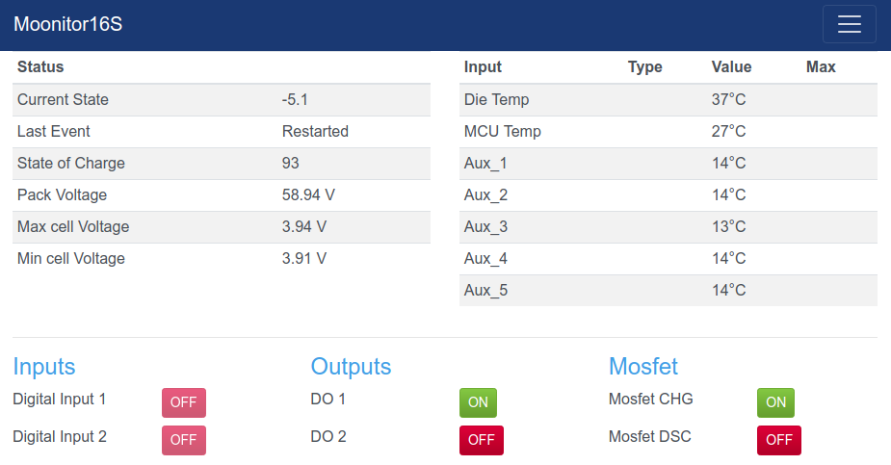

Slide 9
Brief Description
Monitors and Balances 6-to-16 Lithium chemistry Cells
Automotive grade hardware design
16 bit high performance 30 channel ADC
Redundancy on hardware functions
Redundant MCU design
10 temperature readings
Engineered for high system Robustness
Designed for Functional Safety Standard Requirements

Slide 10
Possible Applications
Electric and Hybrid Electric Vehicles (EV)
Single board up to 80V Energy Storage (EES) Systems
High-Reliability Automotive applications
Power-Wall
Solar/wind powered storage systems
Small scale electrical cars/motors/scooters
Backup power storages
Grid tied systems

Slide 11
Protections
Over Voltage
Under Voltage,
Over Temperature,
Under Temperature,
Open Wire detection,
Communication faults,
Ground lose protection, ( Space grade )
Emergency contractor protection ( Automotive grade )

Slide 12
Hardware specs
2 Automotive grade Digital input
2 Automotive grade Digital output
High current e-fuse ( Solid state )
Thermal Shutdown
Emergency Shot down
Under 1 watt continuous power consumption

Slide 13
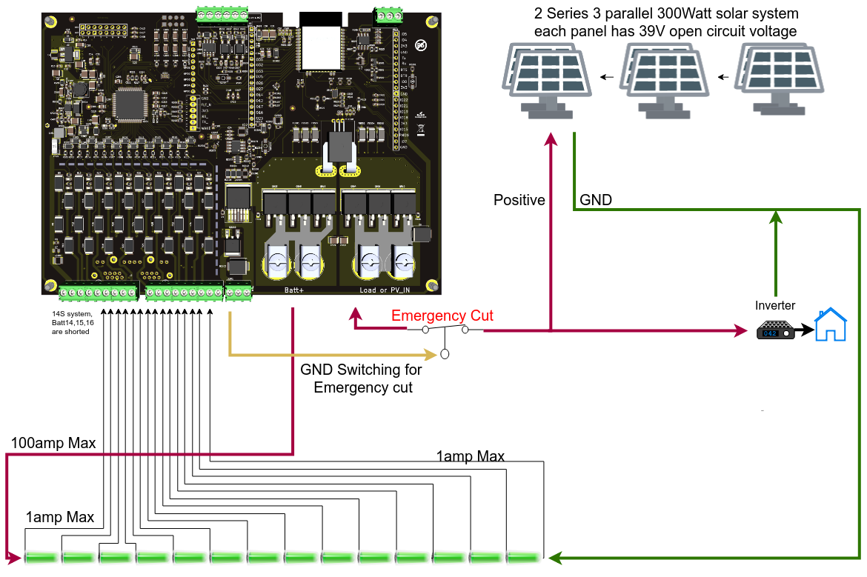

Slide 14
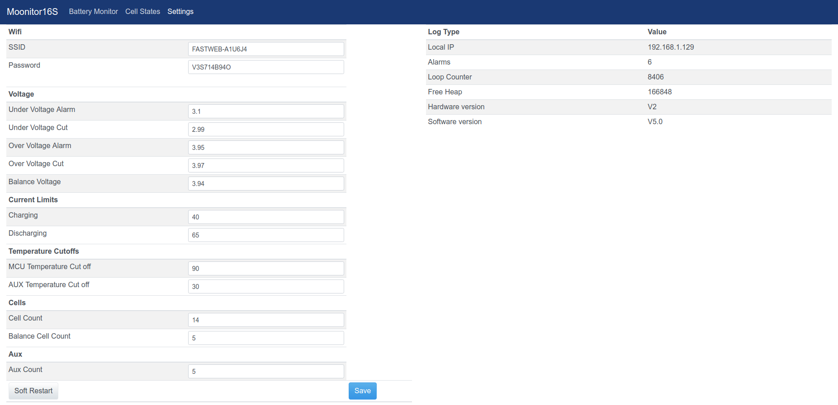

Slide 15
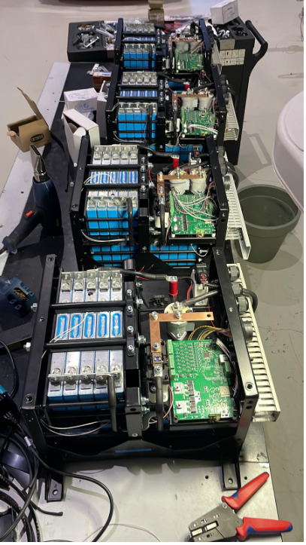
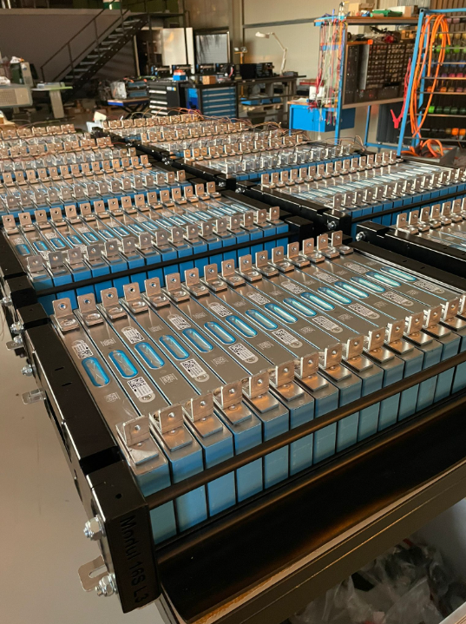

Slide 16
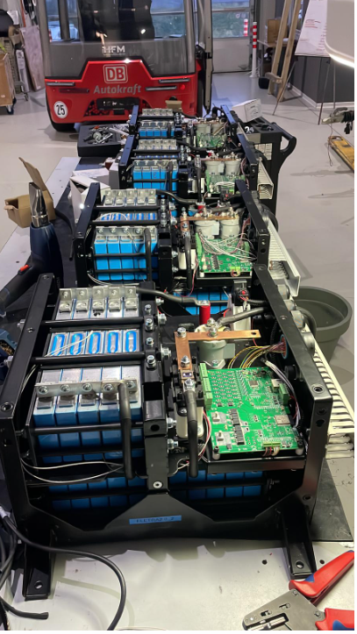
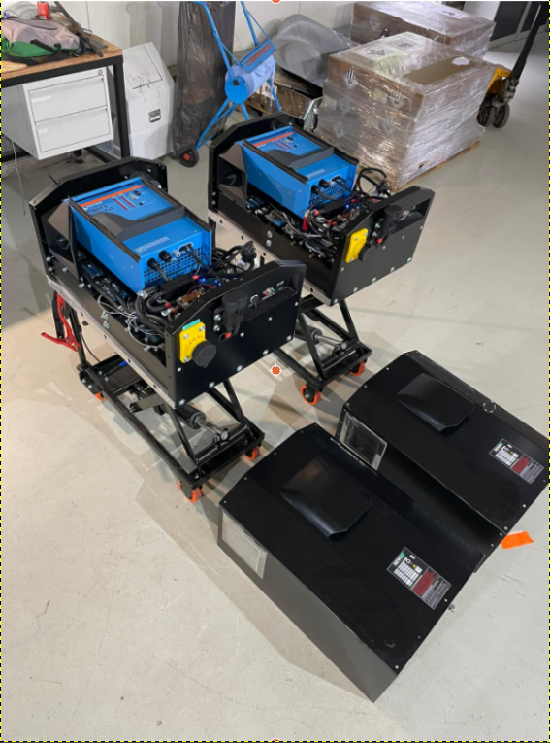

Slide 17
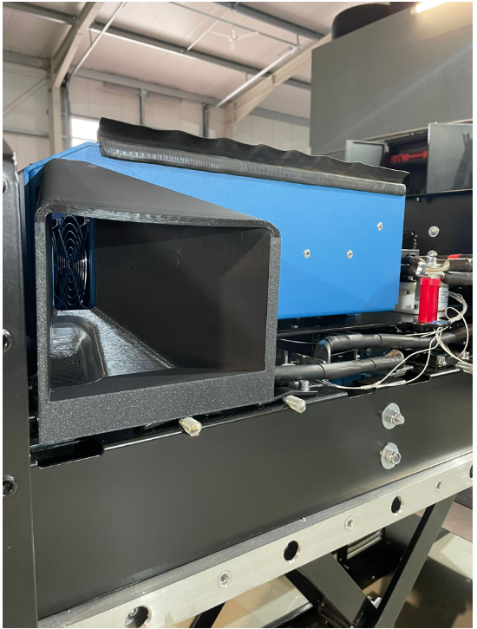
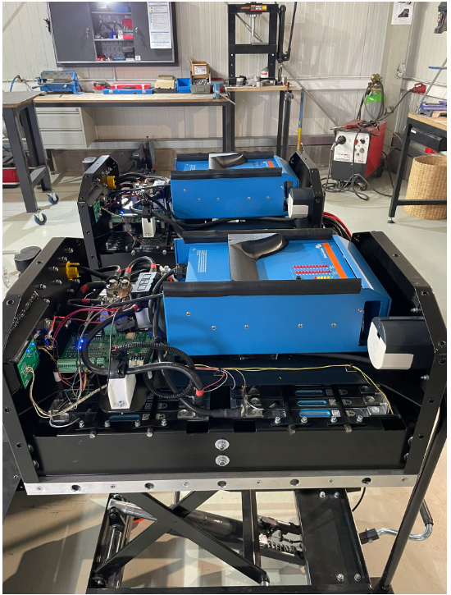

Slide 18
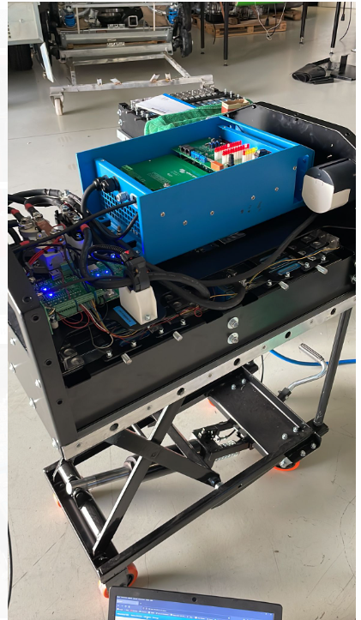
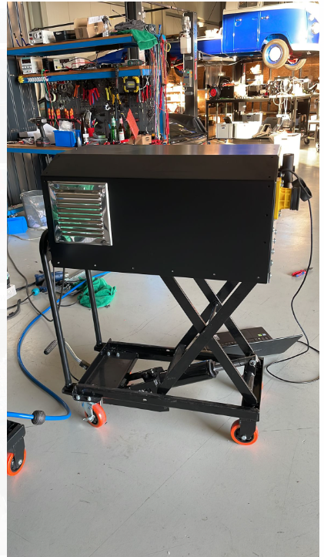

Slide 19
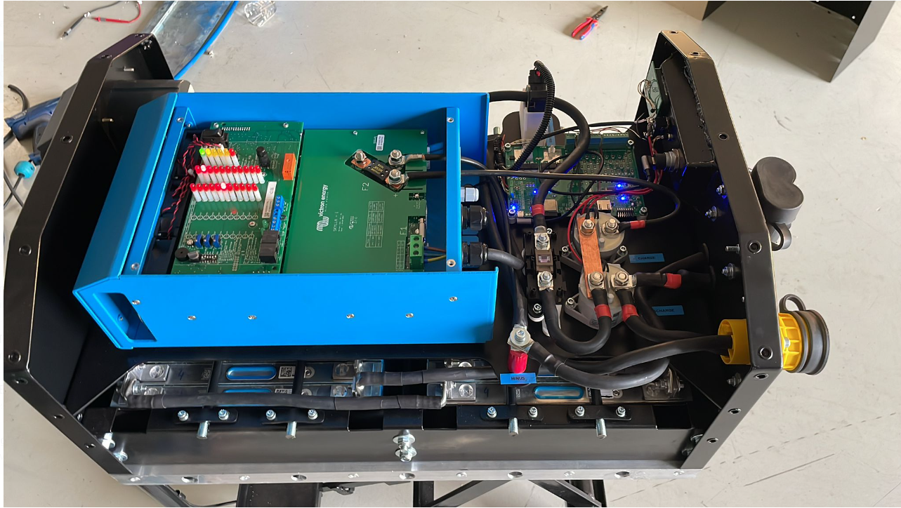

Slide 20
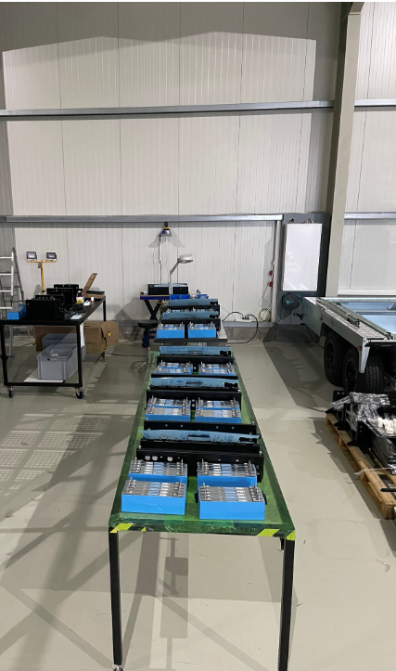
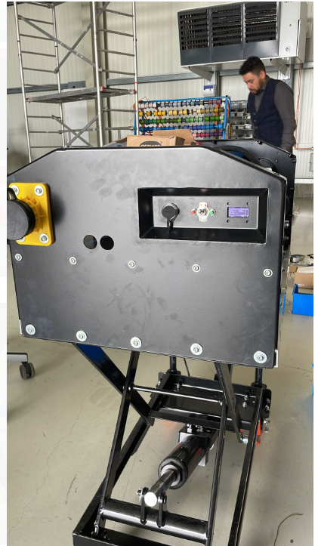

Slide 21
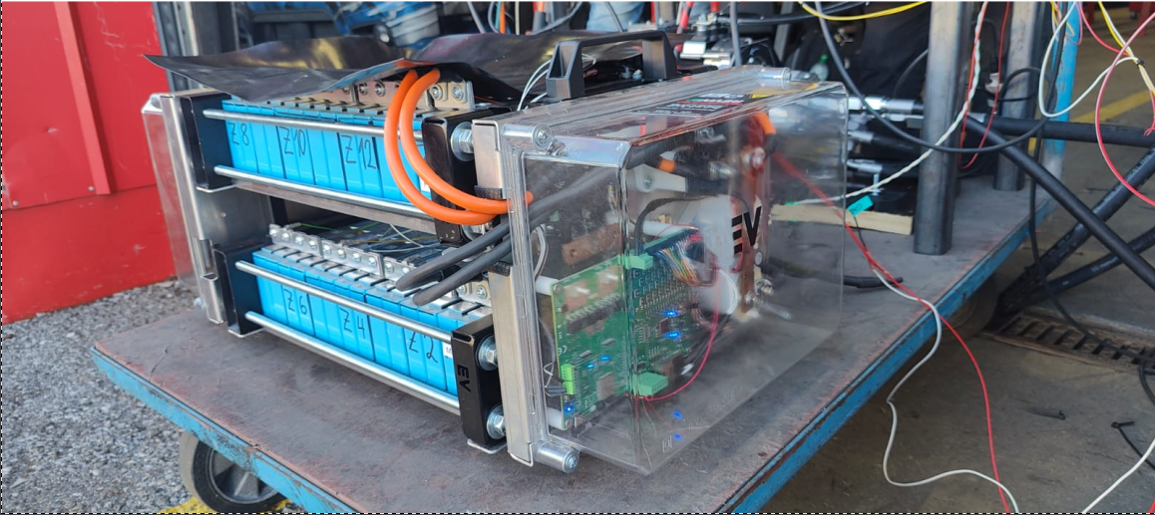

Slide 22
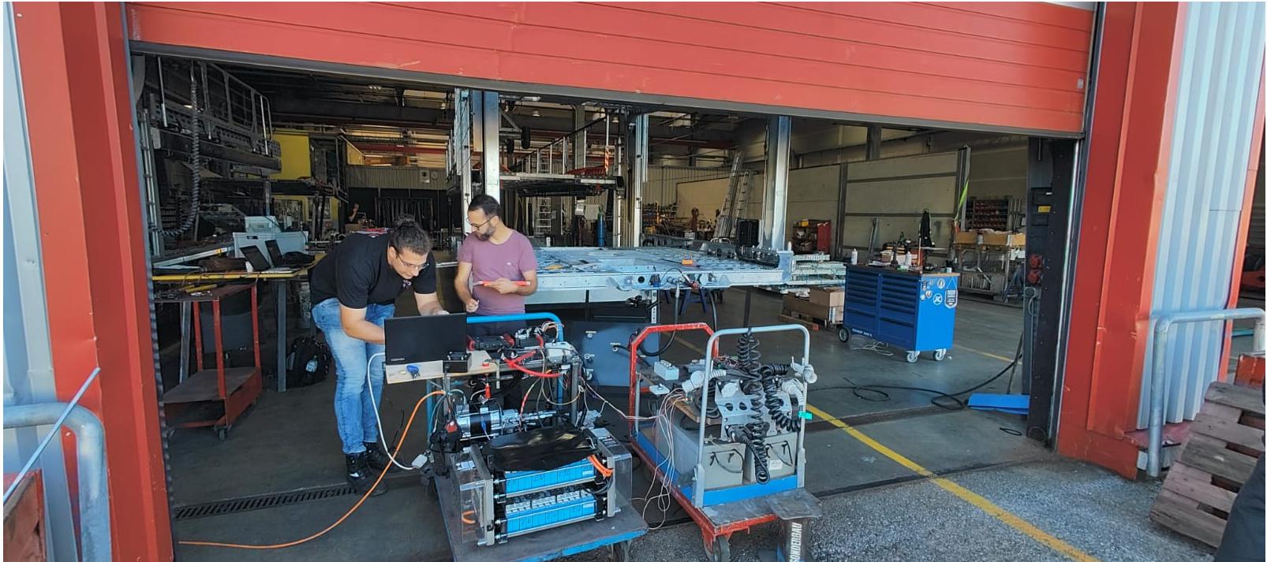

Slide 23
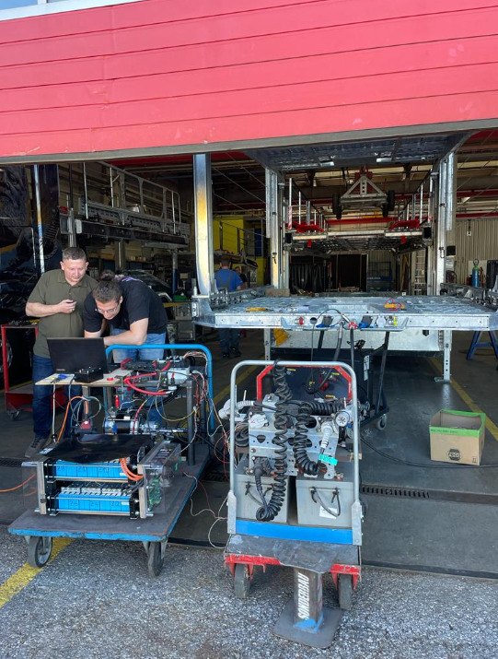
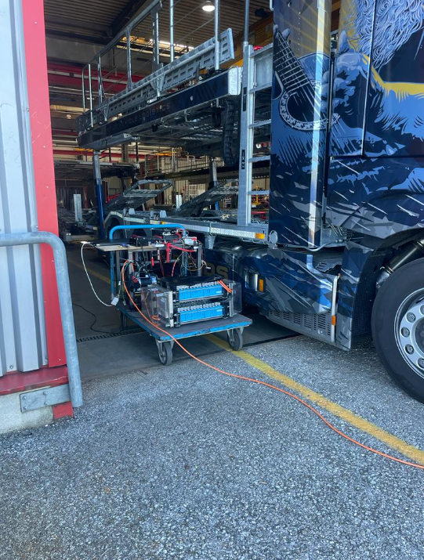

Slide 24
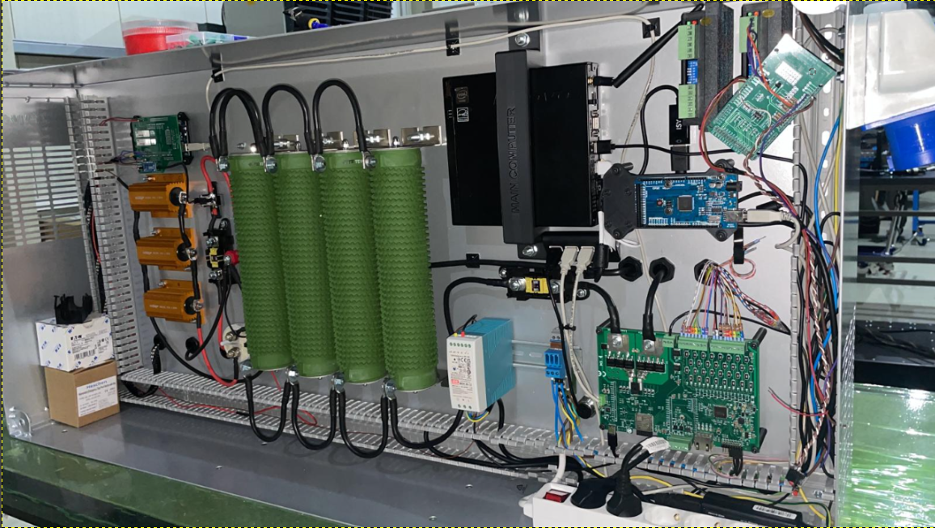

Slide 25
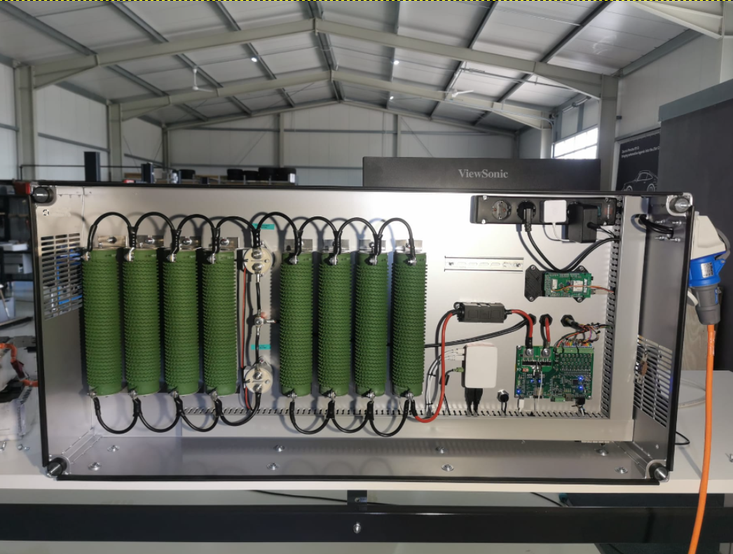

Slide 26
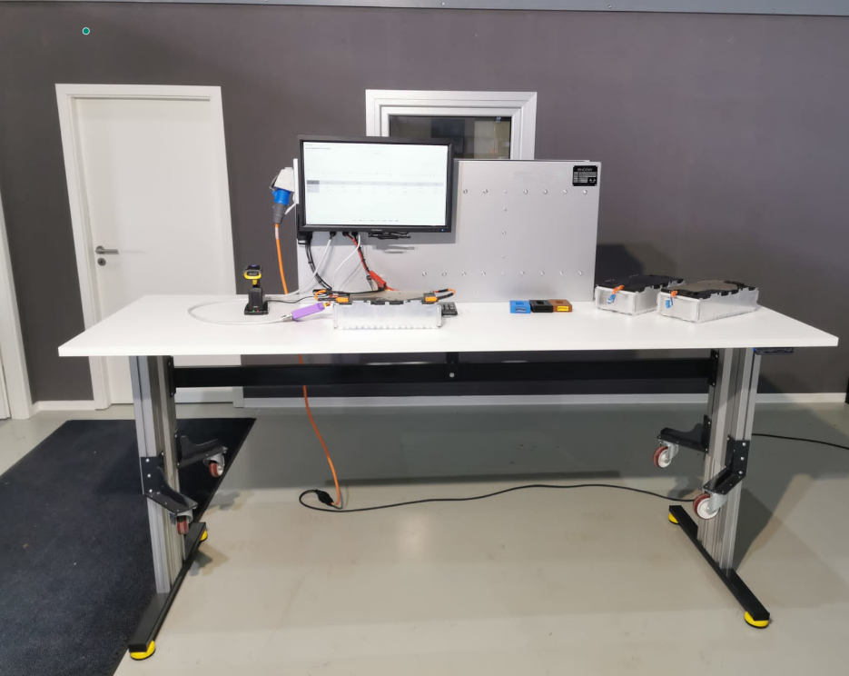

Slide 27
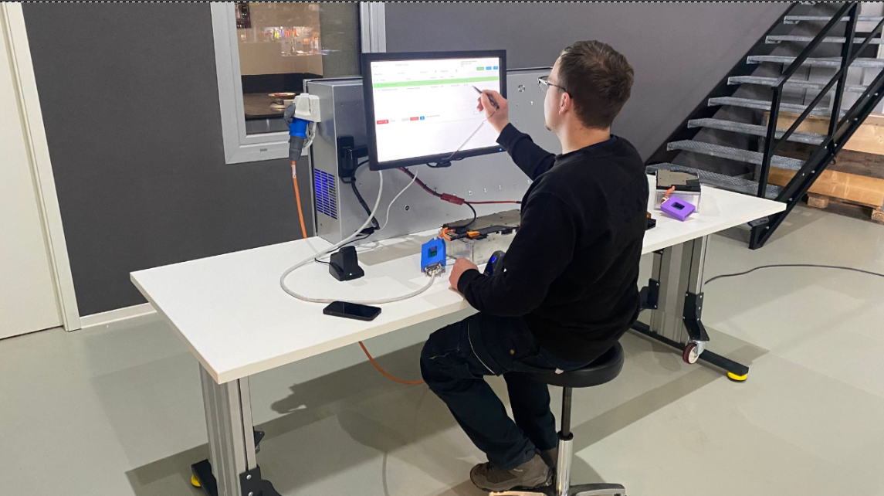

Slide 28
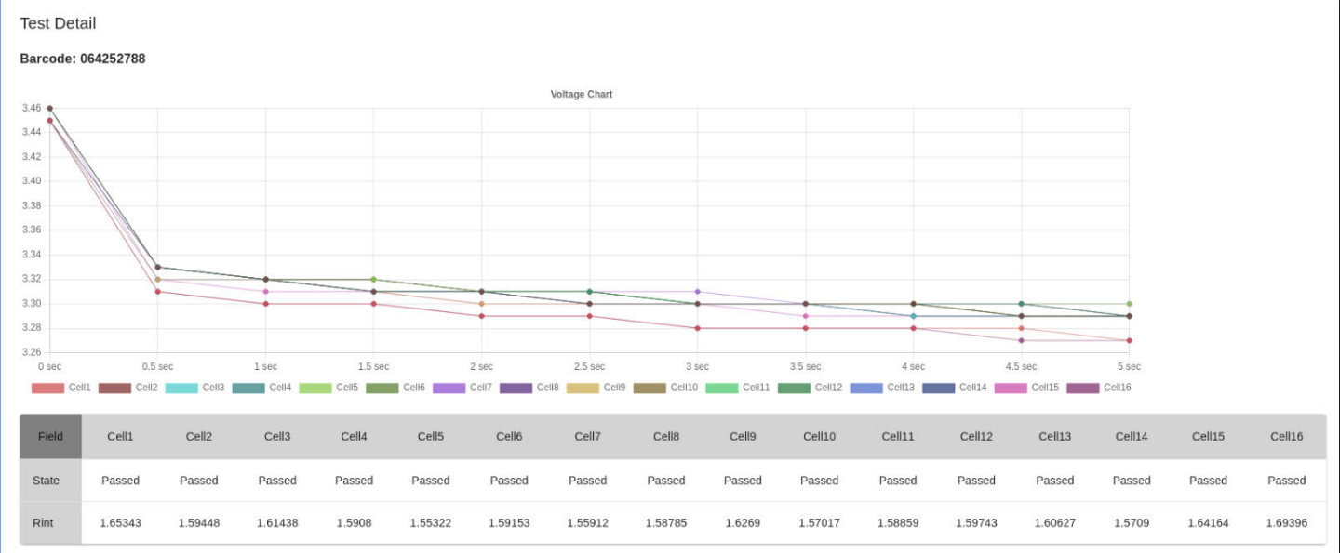

Slide 29
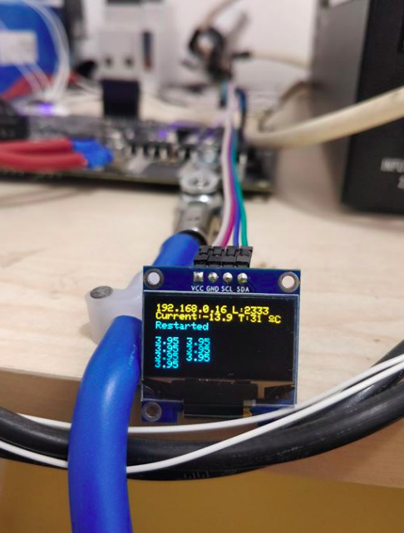

Slide 30
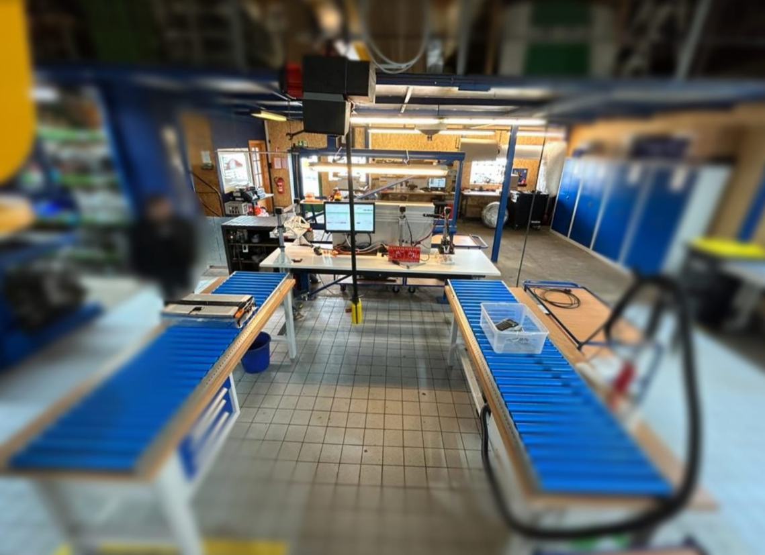

Slide 31
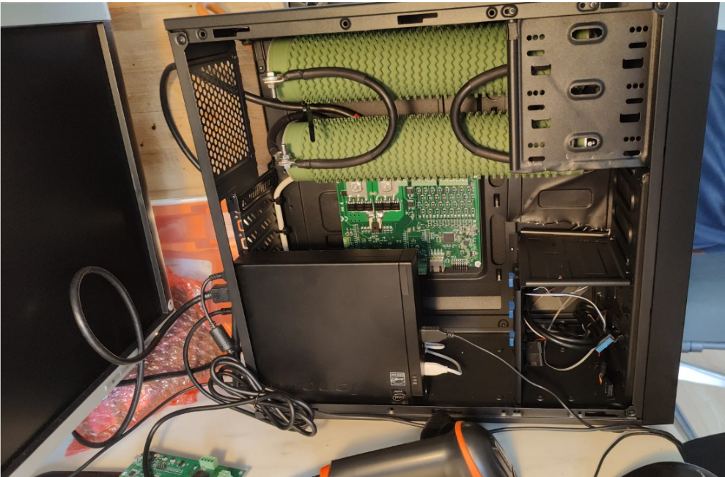

Slide 32
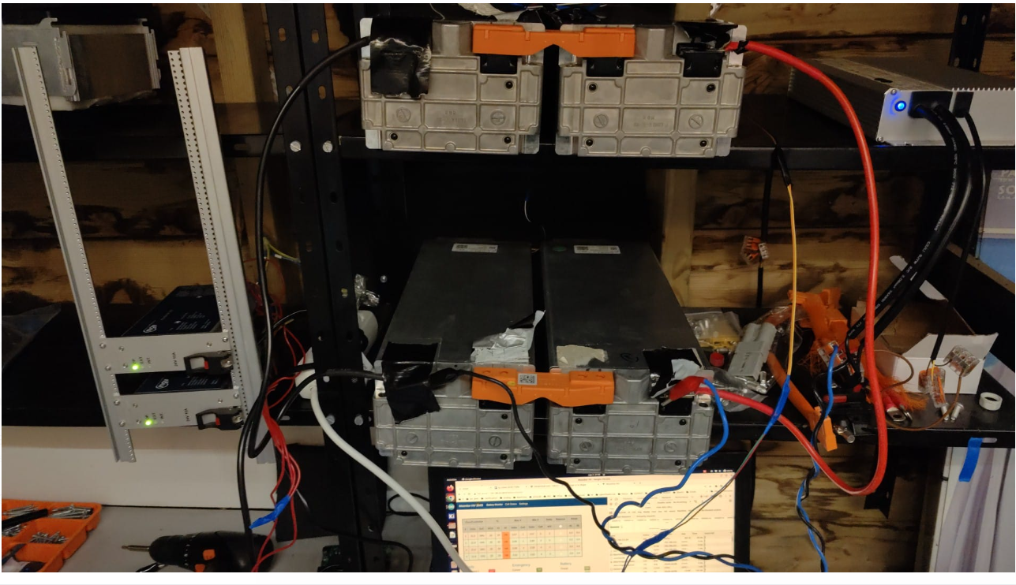

Slide 33


Slide 34
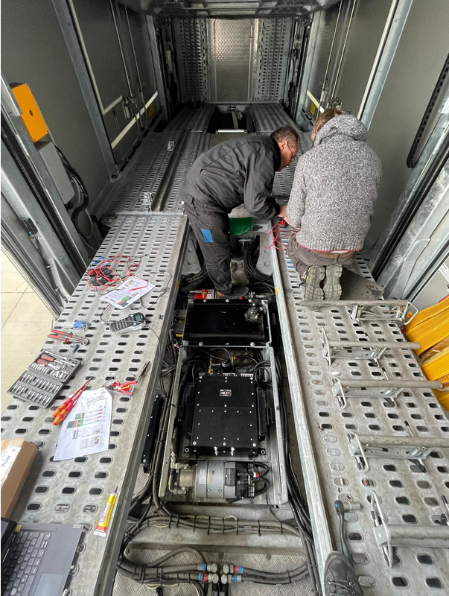

Slide 35
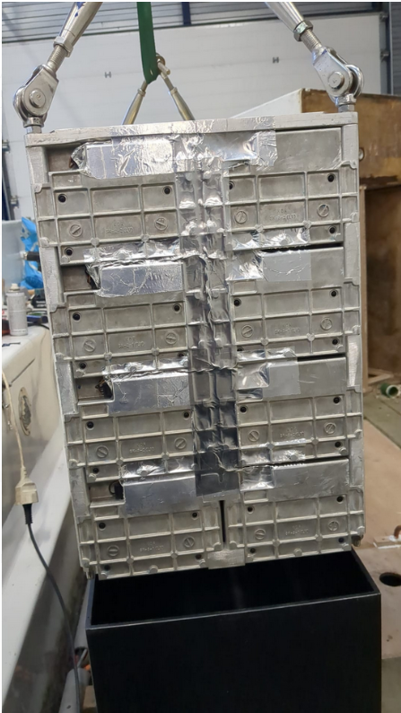

Slide 36
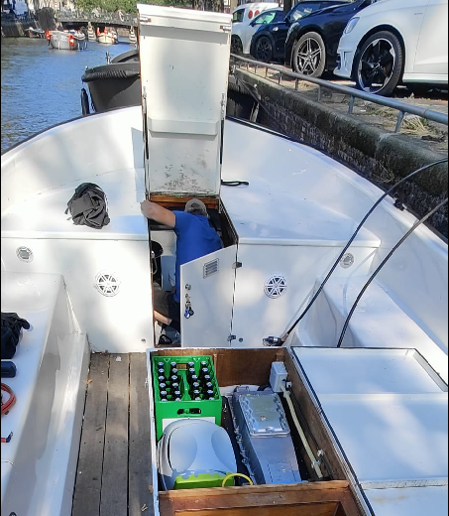
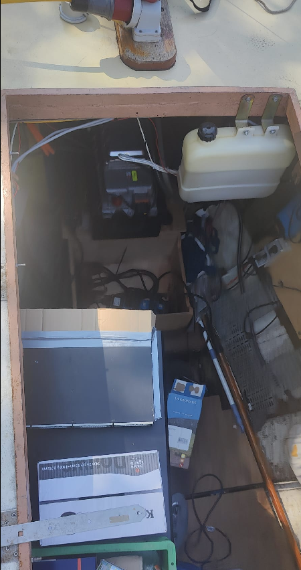

Slide 37


Slide 38


Slide 39
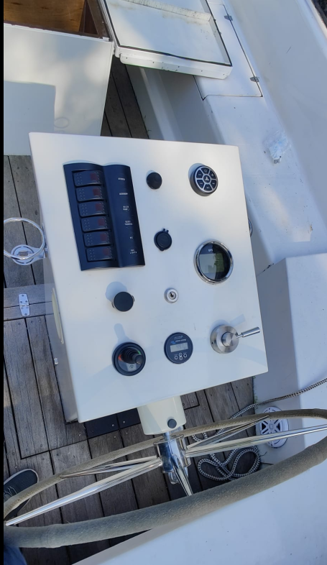

Slide 40


